Slide 1
Software Configuration Management Plan
Viswanathan Hariharan

Slide 2
Contents
Introduction to SCM
Need for Configuration management
Configuration management function
Configuration Management responsibilities

Slide 3
Introduction
Change management is one of the fundamental activities of software engineering
  Change to requirements leads to change in design,
  change to design leads to change to code, and so on
  Another source of change is defects found during testing
So we need to be able to keep together a set of work products that constitute the software – requirements, design, programs, test plans, documentation, etc.
These work products (configuration items) together constitute a configuration of software
Software configuration
Design
Req
Programs
Test
cases
…..

Slide 4
Need for Configuration management
The most frustrating software problems are often caused by poor config. management
Ex.
  A difficult bug that was fixed at great expense, suddenly reappears
  A developed & tested feature is mysteriously missing
  A fully tested program, suddenly does not work
Conflicts can be due to
  Bug fixes done in production are not propagated to versions in development, testing. Later when the development version gets to production, the bug reappears

Slide 5
Propagating changes to different environments
Propagate change
Propagate change
Change to software to fix a bug
Development
environment
Quality
environment
Production
environment
Software
Software
Software
Promote
Promote

Slide 6
Need for Configuration management
Conflicts can be due to
  Bug fixes done in production are not propagated to versions in development, testing. Later when the development version gets to production, the bug reappears
  Simultaneous update by 2 or more programmers on same code
  Common code modifications are not communicated to all
CM helps reduce these problems by coordinating work of many different people
  Provides central repository of work products
  Controls changes – when 2 people want to change a work product
  Helps sharing common work products – so everyone has latest work product
  Helps track changes to work products – so one can revert to a previous version if needed

Slide 7
Configuration management function
Establish a baseline of the software, along with work products that produced it such as requirement, design, test cases, etc.
  Baseline establishes one official copy of the code, which all team members can use to make changes
Revise the baseline, when things change, consisting of revised work products

Slide 8
Baseline configuration
Baseline configuration
Design
Req
Programs
Test
cases
…..
Change
Revised configuration
Design
Req
Programs
Test
cases
…..

Slide 9
Revisions
When requirement changes, it is useful to maintain each revision of each module
Keeping track of revisions is an important task of config mgmt.
Baseline
Revision 1
Revision 2
Revision 3

Slide 10
Revisions
Maintaining these revisions helps track the location of defect.
When something stops working,
  Start from the baseline where it was working
  Then introduce each revised module one by one and test whether the system is working
  The moment it stops working, we know the revision of the module that caused the problem
Baseline
Revision 1
Revision 2
Revision 3

Slide 11
Versions
When products are modified to suit different functional needs of another set of customers, we create a different version of the software
Most of the modules will be same across versions except a few modules

Slide 12
Revision & Version
Another Version
Version 3
Baseline
Revision 1
Revision 2
Revision 3
Version 2
Version 2
(Revision 1)
New Version for a different customer

Slide 13
Sample steps to revise software
Team member 2
Program 2
Change &
Test
Program 1
Program 3
Check-out
Check-in
Freeze
System test & Regression test
Baseline
Program 1
Program 2
Program 3
Check-out
Check-in
Team member 1
Program 1
Change &
Test
Program 2
Program 3

Slide 14
Baseline
This is the foundation of CM
Changes to Baseline must be authorized
At the same time, programmers should be able to readily modify & test their code
This is achieved by providing private working copies of a part of the baseline
Each change should be tested against a trial version of the baseline
During final regression testing, no code should be changed

Slide 15
Config management records
Every change proposal (change request) is documented & authorized before change is made
Change log is maintained to know what parts are getting changed
Problem reports containing problem description along with precise conditions that caused it are recorded
‘Expect list’ gives list of features & functions expected in next baseline

Slide 16
Sample Change Request Form
Show a sample CR form

Slide 17
CM responsibilities
Module owner
  Module owner is the Control point for all changes to a module
  Provides advice to people working on the module or interfacing with the module
  Reviews changes to module and conducts regression test
Change Control Board (CCB)
  Determines whether the change should be made – Approve, Disapprove, Defer
  Determine conditions under which the changes made can be released. CCB may deem the following necessary before release
    Performance analysis
    User review
  Should have expertise and authority over a particular area

Slide 18
Need for automated tools
Software development activity consists of a lot of detail such as
  Configuration items, Change Request, Problem report, CCB actions, Activity log
Hence a tool will aid in maintaining such information
Also the tool can generate useful statistics such as ‘Mean time to close the change’
An example of how the statistics helped in one situation
  Rate of changes being made to a module was high
  On closer examination, it was found that the module had design problem
  The manager was able to provide timely help

Slide 19
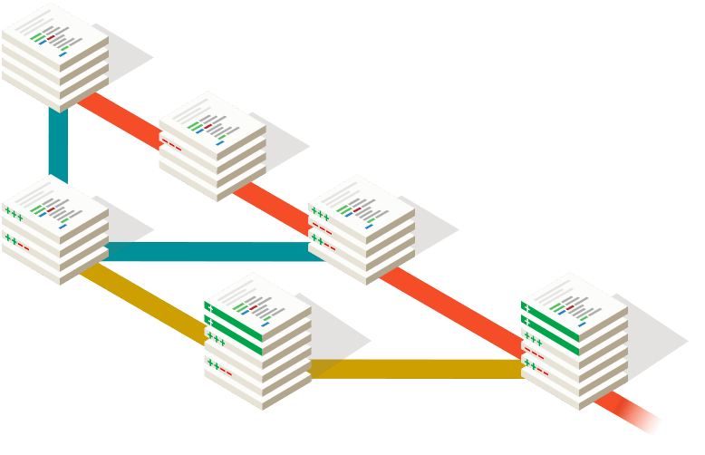
GIT – a popular Config mgmt. tool
https://git-scm.com/
Git is a free and open source distributed version control system designed to handle everything from small to very large projects with speed and efficiency.
Main features of GIT
Branching & merging – Branch, try new ideas, Merge
Distributed – central & local copies
Staging area – Intermediate area where changes can be reviewed

Slide 20
Importance of SW config mgmt
Many programs live long and they undergo change – bug fixes, enhancements
When design is not kept in sync with programs changes, subsequent changes to code are made with insufficient knowledge of design or logic behind it
Thus defects may creep in and the entropy (chaos) of SW keeps increasing

Slide 21
Importance of SW config mgmt
When the original designer leaves the project, it takes time to go through someone else’s code without supporting design documents
In many organizations, SW is the life line of business & hence SW is an investment
If we need continued value from this investment, we need to have config management

Slide 22
Config items
Typical items under config control are:
Requirement
Design, along with rational for design decisions
Source code
Object code
Test plan
Test cases, Test data, Test results
Development tools & their version
User manual
….
+ Mapping between requirement & design, Design & code, Requirement & Test cases, etc.

Slide 23
Example of Traceability matrix
<Show a sample Traceability Matrix template>

Slide 24
SW Config management system should support questions like
Get config. items of the original baseline
What changes were made, when, by whom?
Who authorized the changes?
What is the impact of a requirement change on design, modules, programs, test cases, etc.?
What changes are planned in future release?

Slide 25
Conclusion
As requirements evolve - during & after development, Software Configuration Management provides crucial support in managing a large software project

Slide 26
Homework
Study the features of GIT
Write a short note on GIT, based on your understanding
How is configuration management done in your organization?

Slide 27
Appendix

